Slide 1
Kubernetes Hands On
Part 2

Slide 2
Github Repository
Please clone the repository for all the files, commands and instructions
https://github.com/keshavprasadms/kubernetes-training

Slide 3
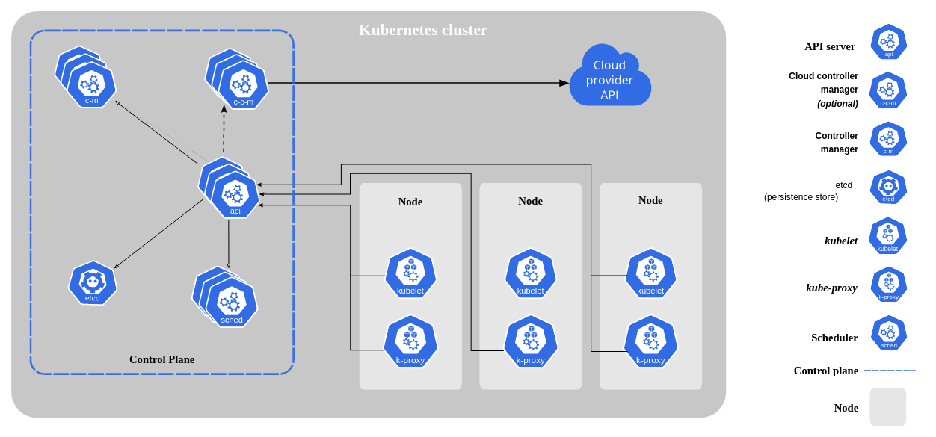
Kubernetes
Kubernetes, also known as K8s, is an open-source system for automating deployment, scaling, and management of containerized applications

Slide 4
Hands On
Part 2 Hands on exercise
https://github.com/keshavprasadms/kubernetes-training/blob/main/Part2/part2-commands.md

Slide 5
Docker Swarm vs Kubernetes
Swarm
Lightweight and easy to understand
No Autoscaling
No cloud provider integrations
Limited Access Control
Lower Cost
Has load balancing out of the box
Kubernetes
Complex and difficult to understanding
Autoscaling
Cloud provider integrations
Advanced Access Control
Higher Cost
Need additional setup for load balancing

Slide 6
Containerd and Podman
Containerd
An alternative to docker engine
Uses crictl as the command line tool
Containerd Hands On
Installing containerd and crictl
Running containers on containerd
Accessing containers / pods using crictl
Podman
Pod man is an alternative to docker cli
Exactly like the docker command
Podman Hands On
Building container images using podman
Running containers using podman
Accessing containers using podman

